Slide 1
Session 3: Outcome Mapping and Indicator Development- I
22nd July 2025

Slide 2
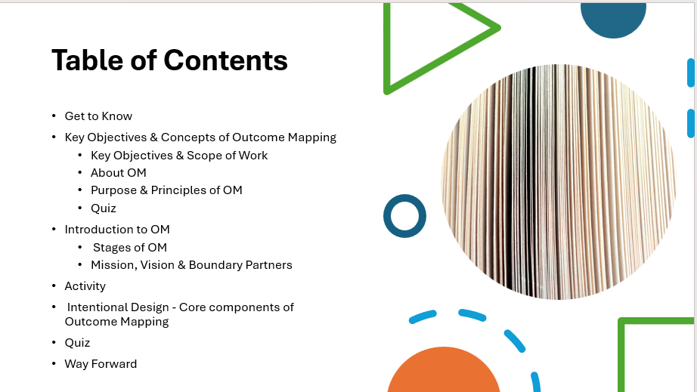
Outline
Before getting Started
Get to Know
Key Objectives & Concepts of Outcome Mapping
Key Objectives & Scope of Work
About OM
Purpose & Principles of OM
Quiz
Introduction to OM
Stages of OM
Mission, Vision & Boundary Partners
Activity
Intentional Design - Core components of Outcome Mapping
Quiz
Way Forward

Slide 3

Get to Know
Before we start, please scan the QR code to share your profile and expectations for the session.
Link: https://forms.fillout.com/t/g85Tn9vRWWus

Slide 4
Key Objectives & Concepts of Outcome Mapping

Slide 5
Scope of work
🕒 Total Duration: 2 Hours
🧩 Number of Sessions: 2
Session 3 (2 Hours):
Topics Covered:
Key Concepts of Outcome Mapping
Principles and Uses of Outcome Mapping
Progress Markers and Validating Lenses
Stages of OM: Intentional Design
Session 4 (2 Hours):
Stages of OM: Outcome & Performance Monitoring
Stages of OM: Evaluation Planning
Key Objectives
Understand the context – Learn about the background and key issues to identify the right kind of outcomes.
Learn the process – Go step-by-step through how Outcome Mapping works.
Review and refine outcomes – Use key questions and tools to check if outcomes are realistic and meaningful.
See where it’s used – Explore examples of how Outcome Mapping has been applied in different programs.

Slide 6

About Outcome Mapping
Example: 300 households from Indigenous communities claim and receive land titles and Record of Rights (ROR) for Individual Forest Rights (IFR) and Community Forest Rights (CFR) under Forest Rights Act (FRA).
OUTCOME MAPPING
OM is an approach that helps unpack an initiative’s theory of change and provides a framework to collect data on the immediate, basic changes that lead to longer, more transformative change.
OUTCOME
An observable and significant change in behaviour, relationships, actions, activities, policies, or practices of an individual, group, community, organisation or institution
Example: 70% of women from self-help groups (SHGs) report increased decision-making power in significant household financial investments-Wedding, purchase of property, College Education and Jewellery , by March 2026,
Example: 80% of Unorganised sector workers collectivise, raise voice and demand redressal against unfair and/exploitative labour practices and denial of rights and entitlements. They obtain benefits from social security schemes and public and private safety nets., by June 2025.

Slide 7
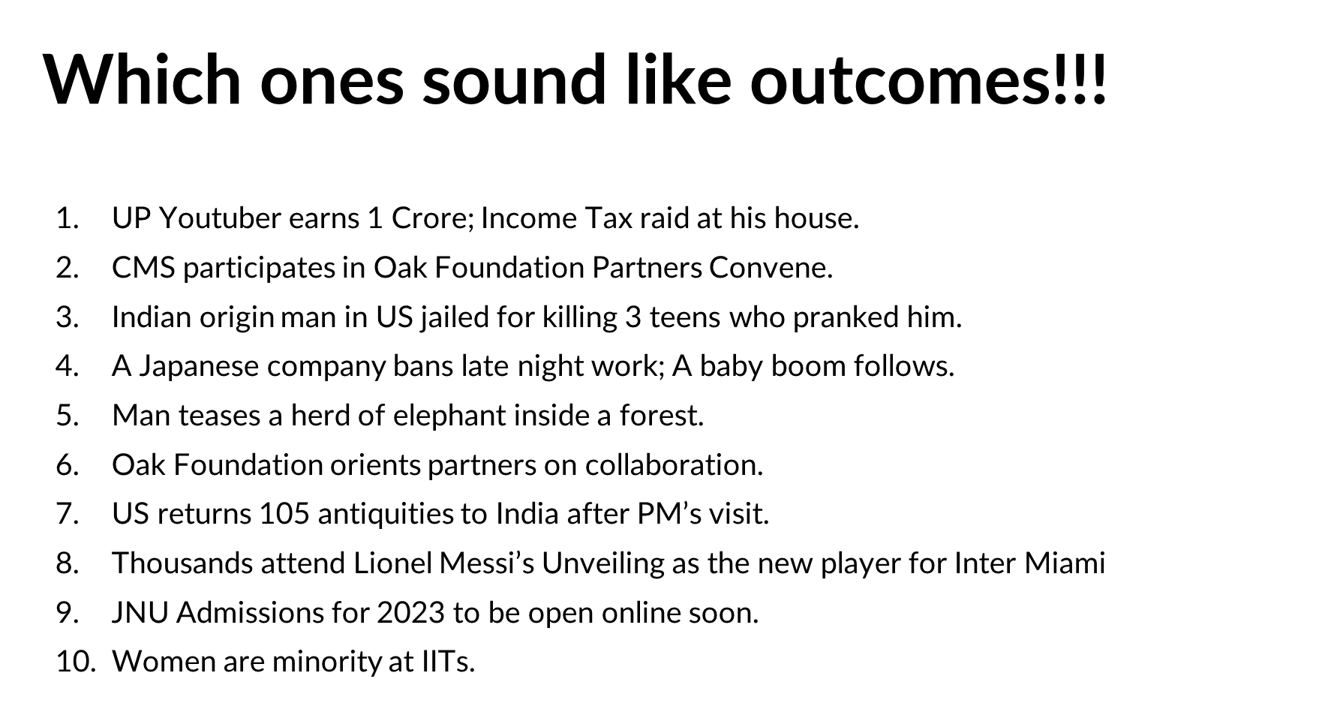
About Outcome Mapping

Slide 8
Purpose of Outcome Mapping
Sphere of Concern Long-term changes desired but beyond direct influence of the intervention; may occur through actions of external key actors. Impact
Sphere of Control What can be directly controlled by an intervention? Input, Activity, Output
Sphere of Influence What can be directly influenced but not controlled Outcome
Boundary Partners
Key actors within the intervention’s sphere of influence whose behavioral changes are essential to achieving goals.
Causal contribution Recognising that multiple factors combine to produce a result, and therefore an intervention will never be the only reason for changes in boundary partners and social actors.
Notes:
Sphere of Control(Based on the provided documents, the Sphere of Control, referring to what can be directly controlled by an intervention, includes:
Capacity Building Activities:
Training on MEL principles, framework integration, and standardization across projects (e.g., Oak-Systems Document-MLE Support_OAK FPAI).
Training on data management, quality assurance, and visualization techniques (e.g., Oak-Systems Document-MLE Support_OAK FPAI).
Workshops on using digital dashboards and interpreting data visualizations (e.g., Oak-Systems Document-MLE Support_OAK FPAI).
Resource Allocation:
Providing seeds for climate-smart agriculture (e.g., DRSC- Sunderbans).
Distributing ducklings for alternative livelihoods (e.g., CPF).
Allocating funds for quality control mechanisms (e.g., Oak-Systems Document-MLE Support_OAK FPAI).
Development and Implementation of Frameworks and Protocols:
Developing MEL framework templates (e.g., Oak-Systems Document-MLE Support_OAK FPAI).
Creating data validation checklists (e.g., Oak-Systems Document-MLE Support_OAK FPAI).
Establishing SOPs for data entry and reporting (e.g., Oak-Systems Document-MLE Support_OAK FPAI).
Awareness Campaigns and Community Mobilization:
Conducting community meetings to discuss worker grievances (e.g., Nazdeek).
Organizing rallies to promote gender equality (e.g., Indraprastha Srijan Welfare Society).
Facilitating discussions on climate change (e.g., ECS).
Stakeholder Engagement and Relationship Building:
Organizing stakeholder meetings to discuss policy and interventions (e.g., ECS).
Facilitating meetings between community groups and PRI representatives (e.g., Baikunthapur Tarun Sangha).
Data Collection and Monitoring:
Implementing real-time data collection systems (e.g., Oak SDD_BRLF).
Conducting baseline and endline surveys (e.g., Oak SDD_BRLF).
Establishing mechanisms for data validation and quality control (e.g., Oak SDD_BRLF).
Creation of Platforms and Spaces:
Establishing community seed banks (e.g., Mukti).
Setting up learning alliances (e.g., WFP).
Organizing children's parliaments (e.g., TDH).
Source: Multiple journal entries
)Causal Contributions(Based on the journals, the causal contributions, where multiple factors combine to produce a result, include:
Community Awareness and Engagement: Community awareness, collective decision-making, and proactive engagement with local governance structures contribute to addressing issues like water congestion. (Source: SDD_BRLF)
Capacity Building and Training: Training programs, workshops, and hands-on sessions equip community members with the knowledge and skills needed to address local challenges and promote sustainable practices. (Source: SDD_BRLF)
Collaboration and Partnerships: Collaboration between community groups, local government, and external organizations enhances the effectiveness of interventions and ensures access to resources and support. (Source: SDD_BRLF)
Empowerment and Leadership: Empowering women and marginalized groups, providing leadership training, and creating platforms for participation enable them to take action and influence decision-making processes. (Source: SDD_BRLF)
Access to Information and Resources: Providing access to information on social welfare schemes, entitlements, and best practices empowers communities to make informed decisions and access available resources. (Source: SDD_BRLF)
Local Governance and Institutional Support: Engagement with local governance structures, such as panchayats and government departments, ensures that community needs are addressed and that interventions are aligned with local development plans. (Source: SDD_BRLF)
Addressing Systemic Issues: Addressing systemic issues such as gender inequality, social norms, and power dynamics is crucial for creating lasting change and promoting equitable outcomes. (Source: SDD_BRLF)
Leveraging External Expertise: Engaging external experts and consultants can provide technical guidance, support capacity building, and facilitate the development of effective MEL systems.
) Based on the provided journals, the boundary actors include:
Gram Panchayats (GPs): Their involvement in addressing community needs and allocating budgets for child protection activities is crucial. (Source: Oak-Systems Document-MLE Support_OAK FPAI, Sanhita_SDD, Oak SDD_ISWS, Oak SDD_Jan Sahas, Oak SDD_Mukti, Oak SDD_Rupantaran)
PRI (Panchayati Raj Institutions) members: Their support and engagement in community initiatives, especially regarding child safeguarding, gender equity, and social norms, are essential. (Source: Oak-Systems Document-MLE Support_OAK FPAI, Sanhita_SDD, Oak SDD_ISWS, Oak SDD_Jan Sahas, Oak SDD_Mukti, Oak SDD_Rupantaran)
ICDS Workers: Their role in identifying and supporting vulnerable children, as well as promoting health and hygiene, is vital. (Source: Oak-Systems Document-MLE Support_OAK FPAI, Sanhita_SDD, Oak SDD_ISWS, Oak SDD_Jan Sahas, Oak SDD_Mukti, Oak SDD_Rupantaran)
ASHAs (Accredited Social Health Activists): Their participation in community health initiatives and their ability to provide support and information to women and children are critical. (Source: Oak-Systems Document-MLE Support_OAK FPAI, Sanhita_SDD, Oak SDD_ISWS, Oak SDD_Jan Sahas, Oak SDD_Mukti, Oak SDD_Rupantaran)
School Teachers: Their involvement in identifying and addressing issues such as irregular school attendance, child marriage, and mental health concerns is essential for ensuring children's well-being and access to education. (Source: Oak-Systems Document-MLE Support_OAK FPAI, Sanhita_SDD, Oak SDD_ISWS, Oak SDD_Jan Sahas, Oak SDD_Mukti, Oak SDD_Rupantaran)
Community Task Force Members (CTF): Their participation in health awareness programs and their ability to disseminate information within the community are crucial for promoting better health practices. (Source: Oak-Systems Document-MLE Support_OAK FPAI, Sanhita_SDD, Oak SDD_ISWS, Oak SDD_Jan Sahas, Oak SDD_Mukti, Oak SDD_Rupantaran)
Small and Marginal Farmers: Their adoption of climate-smart agricultural practices and their engagement in sustainable livelihoods are essential for building climate resilience and improving food security. (Source: Oak-Systems Document-MLE Support_OAK FPAI, Sanhita_SDD, Oak SDD_ISWS, Oak SDD_Jan Sahas, Oak SDD_Mukti, Oak SDD_Rupantaran)
Women and Adolescent Groups: Their active participation in community meetings, decision-making processes, and advocacy efforts is crucial for promoting gender equality and addressing social issues. (Source: Oak-Systems Document-MLE Support_OAK FPAI, Sanhita_SDD, Oak SDD_ISWS, Oak SDD_Jan Sahas, Oak SDD_Mukti, Oak SDD_Rupantaran)
Trade Union Leaders: Their collaboration in raising awareness among tea garden workers on issues such as sexual harassment and their ability to provide support and advocacy are essential for ensuring workers' rights and safety. (Source: Oak-Systems Document-MLE Support_OAK FPAI, Sanhita_SDD, Oak SDD_ISWS, Oak SDD_Jan Sahas, Oak SDD_Mukti, Oak SDD_Rupantaran)
MEL Experts: Their support for methodological training and evaluation framework design is essential for ensuring cross-program comparability and rigor. (Source: Oak-Systems Document-MLE Support_OAK FPAI, Sanhita_SDD, Oak SDD_ISWS, Oak SDD_Jan Sahas, Oak SDD_Mukti, Oak SDD_Rupantaran)

Slide 9
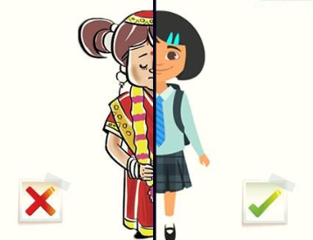

Purpose of Outcome Mapping
Sphere of Influence (Outcome)
Sphere of Control
(Input, Activity, Output )
1. Sessions to girls and leaders about why early marriage is harmful.
2. NGO conducts training sessions for trade union leaders on gender issues and worker rights.
1.Committee starts reporting child marriage. Peer groups spread awareness in schools and villages.
2. Trade union leaders begin raising awareness about sexual harassment and support tea garden workers in reporting cases.
Sphere of Concern (Impact)
1. Fewer child marriages and more girls staying in school.
2. Improved safety and rights for women workers in tea gardens; reduction in harassment cases.
Boundary Partners
1. Child Protection Committee and peer groups.
2. Trade union leaders
3. Govt agencies-Labour Welfare, Women and Child -Social Support Agencies
Causal contribution
1.Police and local leaders help by taking action and joining the awareness drive. 2. NGO’s sessions, Leadership commitment, Workers’ growing trust in union support
Notes:
Sphere of Control(Based on the provided documents, the Sphere of Control, referring to what can be directly controlled by an intervention, includes:
Capacity Building Activities:
Training on MEL principles, framework integration, and standardization across projects (e.g., Oak-Systems Document-MLE Support_OAK FPAI).
Training on data management, quality assurance, and visualization techniques (e.g., Oak-Systems Document-MLE Support_OAK FPAI).
Workshops on using digital dashboards and interpreting data visualizations (e.g., Oak-Systems Document-MLE Support_OAK FPAI).
Resource Allocation:
Providing seeds for climate-smart agriculture (e.g., DRSC- Sunderbans).
Distributing ducklings for alternative livelihoods (e.g., CPF).
Allocating funds for quality control mechanisms (e.g., Oak-Systems Document-MLE Support_OAK FPAI).
Development and Implementation of Frameworks and Protocols:
Developing MEL framework templates (e.g., Oak-Systems Document-MLE Support_OAK FPAI).
Creating data validation checklists (e.g., Oak-Systems Document-MLE Support_OAK FPAI).
Establishing SOPs for data entry and reporting (e.g., Oak-Systems Document-MLE Support_OAK FPAI).
Awareness Campaigns and Community Mobilization:
Conducting community meetings to discuss worker grievances (e.g., Nazdeek).
Organizing rallies to promote gender equality (e.g., Indraprastha Srijan Welfare Society).
Facilitating discussions on climate change (e.g., ECS).
Stakeholder Engagement and Relationship Building:
Organizing stakeholder meetings to discuss policy and interventions (e.g., ECS).
Facilitating meetings between community groups and PRI representatives (e.g., Baikunthapur Tarun Sangha).
Data Collection and Monitoring:
Implementing real-time data collection systems (e.g., Oak SDD_BRLF).
Conducting baseline and endline surveys (e.g., Oak SDD_BRLF).
Establishing mechanisms for data validation and quality control (e.g., Oak SDD_BRLF).
Creation of Platforms and Spaces:
Establishing community seed banks (e.g., Mukti).
Setting up learning alliances (e.g., WFP).
Organizing children's parliaments (e.g., TDH).
Source: Multiple journal entries
)Causal Contributions(Based on the journals, the causal contributions, where multiple factors combine to produce a result, include:
Community Awareness and Engagement: Community awareness, collective decision-making, and proactive engagement with local governance structures contribute to addressing issues like water congestion. (Source: SDD_BRLF)
Capacity Building and Training: Training programs, workshops, and hands-on sessions equip community members with the knowledge and skills needed to address local challenges and promote sustainable practices. (Source: SDD_BRLF)
Collaboration and Partnerships: Collaboration between community groups, local government, and external organizations enhances the effectiveness of interventions and ensures access to resources and support. (Source: SDD_BRLF)
Empowerment and Leadership: Empowering women and marginalized groups, providing leadership training, and creating platforms for participation enable them to take action and influence decision-making processes. (Source: SDD_BRLF)
Access to Information and Resources: Providing access to information on social welfare schemes, entitlements, and best practices empowers communities to make informed decisions and access available resources. (Source: SDD_BRLF)
Local Governance and Institutional Support: Engagement with local governance structures, such as panchayats and government departments, ensures that community needs are addressed and that interventions are aligned with local development plans. (Source: SDD_BRLF)
Addressing Systemic Issues: Addressing systemic issues such as gender inequality, social norms, and power dynamics is crucial for creating lasting change and promoting equitable outcomes. (Source: SDD_BRLF)
Leveraging External Expertise: Engaging external experts and consultants can provide technical guidance, support capacity building, and facilitate the development of effective MEL systems.
) Based on the provided journals, the boundary actors include:
Gram Panchayats (GPs): Their involvement in addressing community needs and allocating budgets for child protection activities is crucial. (Source: Oak-Systems Document-MLE Support_OAK FPAI, Sanhita_SDD, Oak SDD_ISWS, Oak SDD_Jan Sahas, Oak SDD_Mukti, Oak SDD_Rupantaran)
PRI (Panchayati Raj Institutions) members: Their support and engagement in community initiatives, especially regarding child safeguarding, gender equity, and social norms, are essential. (Source: Oak-Systems Document-MLE Support_OAK FPAI, Sanhita_SDD, Oak SDD_ISWS, Oak SDD_Jan Sahas, Oak SDD_Mukti, Oak SDD_Rupantaran)
ICDS Workers: Their role in identifying and supporting vulnerable children, as well as promoting health and hygiene, is vital. (Source: Oak-Systems Document-MLE Support_OAK FPAI, Sanhita_SDD, Oak SDD_ISWS, Oak SDD_Jan Sahas, Oak SDD_Mukti, Oak SDD_Rupantaran)
ASHAs (Accredited Social Health Activists): Their participation in community health initiatives and their ability to provide support and information to women and children are critical. (Source: Oak-Systems Document-MLE Support_OAK FPAI, Sanhita_SDD, Oak SDD_ISWS, Oak SDD_Jan Sahas, Oak SDD_Mukti, Oak SDD_Rupantaran)
School Teachers: Their involvement in identifying and addressing issues such as irregular school attendance, child marriage, and mental health concerns is essential for ensuring children's well-being and access to education. (Source: Oak-Systems Document-MLE Support_OAK FPAI, Sanhita_SDD, Oak SDD_ISWS, Oak SDD_Jan Sahas, Oak SDD_Mukti, Oak SDD_Rupantaran)
Community Task Force Members (CTF): Their participation in health awareness programs and their ability to disseminate information within the community are crucial for promoting better health practices. (Source: Oak-Systems Document-MLE Support_OAK FPAI, Sanhita_SDD, Oak SDD_ISWS, Oak SDD_Jan Sahas, Oak SDD_Mukti, Oak SDD_Rupantaran)
Small and Marginal Farmers: Their adoption of climate-smart agricultural practices and their engagement in sustainable livelihoods are essential for building climate resilience and improving food security. (Source: Oak-Systems Document-MLE Support_OAK FPAI, Sanhita_SDD, Oak SDD_ISWS, Oak SDD_Jan Sahas, Oak SDD_Mukti, Oak SDD_Rupantaran)
Women and Adolescent Groups: Their active participation in community meetings, decision-making processes, and advocacy efforts is crucial for promoting gender equality and addressing social issues. (Source: Oak-Systems Document-MLE Support_OAK FPAI, Sanhita_SDD, Oak SDD_ISWS, Oak SDD_Jan Sahas, Oak SDD_Mukti, Oak SDD_Rupantaran)
Trade Union Leaders: Their collaboration in raising awareness among tea garden workers on issues such as sexual harassment and their ability to provide support and advocacy are essential for ensuring workers' rights and safety. (Source: Oak-Systems Document-MLE Support_OAK FPAI, Sanhita_SDD, Oak SDD_ISWS, Oak SDD_Jan Sahas, Oak SDD_Mukti, Oak SDD_Rupantaran)
MEL Experts: Their support for methodological training and evaluation framework design is essential for ensuring cross-program comparability and rigor. (Source: Oak-Systems Document-MLE Support_OAK FPAI, Sanhita_SDD, Oak SDD_ISWS, Oak SDD_Jan Sahas, Oak SDD_Mukti, Oak SDD_Rupantaran)

Slide 10
Principles of OM
Focus on Behaviour Change → Change is meaningful when it shifts how people act and interact.
Example: Farmers consistently adopt Systemic Crop Intensification after exposure to peer-led training.
Value Local Ownership → People drive their own wellbeing when they have the space to lead and decide.
Example:Male Youth groups in Gram Panchayats independently organize awareness events on Domestic Violence, Bullying, Gender Equity and Inclusion
Build Strong Relationships → Sustainable change depends on trust, collaboration, and shared learning.
Example: NGOs and local panchayats jointly plan and monitor school nutrition programs.
Social, policy & systems changes depend on changes in human behaviour
People contribute to their own wellbeing
Principles
Sustained improvements in people’s lives or environments depend on relationships

Slide 11
Quiz

Slide 12

Quiz 1
Scan the QR code below to participate in the quiz.
Link: https://forms.fillout.com/t/kg6cDkj6EQus

Slide 13
Introduction to Outcome Mapping

Slide 14
Three Stages of OM
INTENTIONAL DESIGN
STEP 1: Vision
STEP 2: Mission
STEP 3: Boundary Partners
STEP 4: Outcome Challenges
STEP 5: Progress Markers
STEP 6: Strategy Maps STEP 7: Organizational Practices
Outcome Mapping is a method for planning, monitoring, and evaluating development programs.
It focuses on behavioral change in the people, groups, or organizations you directly work with (called boundary partners).
Instead of measuring direct impact, it tracks your contribution to change through intentional actions and learning.
EVALUATION PLANNING
STEP 12: Evaluation Plan
OUTCOME & PERFORMANCE MONITORING
STEP 8: Monitoring Priorities
STEP 9: Outcome Journals
STEP 10: Strategy Journals
STEP 11: Performance Journal

Slide 15



Vision & Mission
VISION
Describes the long-term change the program wants to support.
Focuses on broader systemic and behavioral shifts.
Beyond direct control but guides all activities.
Example: Vision: Women tea garden workers live and work in safe, respectful environments.
MISSION
Describes how the program will contribute to the vision.
Focuses on supporting boundary partners to achieve outcomes.
Emphasizes effectiveness, learning, and adaptability.
Example: Mission: Support union leaders and local organizations to raise awareness about rights and help workers report abuse.

Slide 16
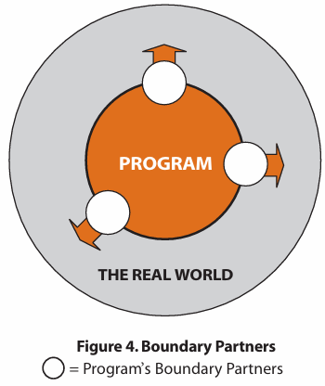
Who are Boundary Partners?
Individuals, groups, or organizations the program works directly with and can influence.
The program does not control them but facilitates change by providing access to resources, ideas, or opportunities.
They are key to achieving outcomes and lie within the program’s sphere of influence, not control.
Examples of Boundary Partners:
Local communities (e.g., NGOs, indigenous groups, community leaders)
Government officials & policymakers (e.g., forest department, regional admin)
Private sector actors (e.g., tourism, fisheries, logging companies)
Academic & research institutions
International institutions

Slide 17
Activity

Slide 18
Activity
Purpose: We expect to apply the concepts of Outcome Mapping [Breakout Room Time- 15 mins]
Expected action: Assume you are running a program. Accordingly, write 2 outcome statements that describe the changes you aim to see in social actors- individuals, groups, or organizations you work with, ensuring they align with your programme’s broader vision and mission.
Format: Social actor to be benefitted + Intended change to happen + Key causal contribution from stakeholder
Examples:
Tea garden workers diversify their livelihoods and adopt climate resilient options.
Migrant and unorganised workers avail rights and entitlements.
Local and district level institutions adopt policies, procedures and practices on child safeguarding.
Indigenous communities manage their forest resources sustainably.
Remarks or Queries:
Link to activity

Slide 19
Intentional Design
Core components of Outcome Mapping

Slide 20
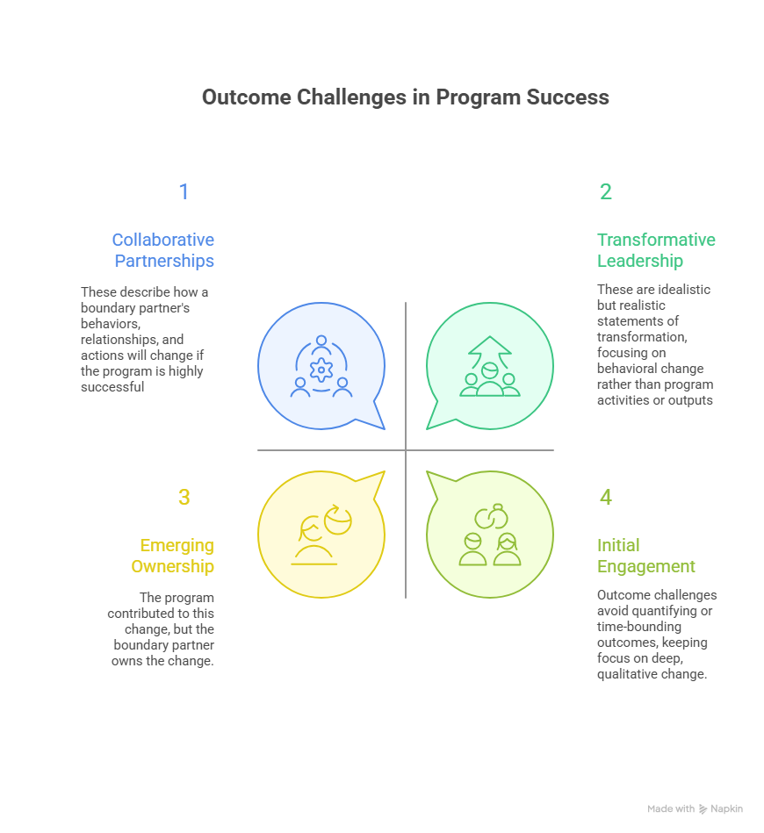
Identify the Outcome Challenge
Collaborative Partnerships
these describe how a boundary partner’s behaviors, relationships, and actions will change if the program is highly successful.
Transformative Leadership
realistic statements of transformation are used, focussing on behavioral change rather than program activities of outputs.
Example- ACV, Learning Alliances and thematic specific coalitions-(Child Protection, Employee Well Being, Indigenous Community and others) would influence policies, behaviour change,, budgets and implementation of system actors
Example- Local government agencies, community-based organizations (CBOs), and NGOs actively collaborate to co-design and implement livelihood initiatives, sharing resources and data to reach 5,000 vulnerable households by 2026.
Emerging Ownership
the program contributed to this change, but the boundary partner owns the change
Initial Engagement
outcome challenges avoid quantifying or time-bounding outcomes, keeping focus on deep qualitative change.
Example-Women’s self-help groups independently manage and expand their savings and loan activities, developing their own rules and partnerships with local banks without external facilitation.
Example- Local women begin attending community meetings and voicing their concerns about access to clean drinking water
Notes:
Add examples
Amplifying Community Voices/ Sundarbans Learning/Cohorts

Slide 21
2. Develop Graduated Progress Markers
Progress markers are a set of behavioral indicators that reflect the depth and complexity of change in a boundary partner.
Initial Partner State
Expect to See
Like to See
Love to See
Transformed Partner State
Early, reactive changes observed
Active engagement and participation
Transformational change achieved
Limited change and engagement
Deep, complex, cumulative change
These marker help the program monitor and understand how boundary partners evolve over time, and track both direct and indirect influence.
The strength of progress markers lies not in individual indicators, but in the cumulative pattern of change they represent.
They should be mutually agreeable, and deadlines should not outweigh meaningful progress

Slide 22
2. Develop Graduated Progress Markers
Progress markers are a set of behavioral indicators that reflect the depth and complexity of change in a boundary partner.
Primary Category | Secondary Category | Indicator Description | Disaggregation | Suggested Evidences to collect | Suggested Methods to collect | Classification dimension
Social sustainability | Equity and inclusivity | SHW survivors in tea and jute sector workplaces who are differently-abled, trans, and migrant women tea workers and participated in IC processes and achieved full restoration (legal redress + services) | Social Identity Group, Geography | Participation logs, IC referrals, service access data | Disaggregated case tracking, IC review audits | Social Sustainability
Resilience | Transformative | % and # of SHW (Sexual Harassment at Workplace) redress cases that result in full survivor restoration (legal justice + access to services) within the statutory timeframe for resolution (90 days) | Gender, Sector | Case closure reports, service referral logs | Legal tracking, survivor tracing | Absorptive Capacity

Slide 23
Primary Category | Secondary Category | Indicator Description | Disaggregation | Suggested Evidences to collect | Suggested Methods to collect | Classification dimension
Social sustainability | Equity and inclusivity | SHW survivors in tea and jute sector workplaces who are differently-abled, trans, and migrant women tea workers and participated in IC processes and achieved full restoration (legal redress + services) | Social Identity Group, Geography | Participation logs, IC referrals, service access data | Disaggregated case tracking, IC review audits | Social Sustainability
Resilience | Transformative | % and # of SHW (Sexual Harassment at Workplace) redress cases that result in full survivor restoration (legal justice + access to services) within the statutory timeframe for resolution (90 days) | Gender, Sector | Case closure reports, service referral logs | Legal tracking, survivor tracing | Absorptive Capacity

Slide 24
3. Complete a Strategy Map
A strategy map is a 2 3 matrix that helps identify the mix of strategies a program uses to support each outcome challenge.
Strategies are classified into - causal, persuasive, and supportive.
The map helps to clarify the program’s influence level, identify strategic gaps, and guide appropriate evaluation methods.
It allows teams to reflect on their strategic focus, ensuring they are not overstretched and are investing effort where they can have the greatest impact.
Persuasive
Uses storytelling and campaigning
Indirect
Direct
Supportive
Causal
Builds networks and partnerships
Provides training and direct support

Slide 25
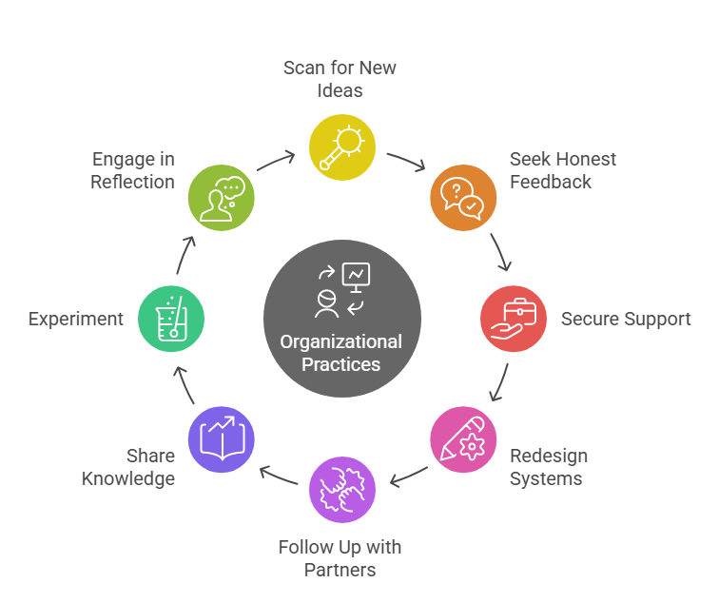
4. Articulate Organizational Practices
Outcome Monitoring
- these practices can be tracked using a performance journal in the monitoring phase, supporting learning and adaptive management.
Purpose
- organizational practices define how a program will operate to stay relevant, effective, and sustainable while contributing to outcome challenges.
Reflection & Adaptation
- these practices encourage regular reflection, learning from unintended outcomes, and continuous improvement of internal processes and external impact.

Slide 26
QnA
(Any discrepancy, query, issues?)

Slide 27
Thank you!

